Slide 1
Neural correlates of musical memory
Proposal Meeting
Avital Sternin
June 21, 2017

Slide 2
Why is memory for music so special?
Can you remember all of the lyrics to your favourite song from high school?
Why do patient’s with Alzheimer’s disease remember lyrics to songs from their youth but may not remember the names of common objects?

Slide 3
Evidence for specific memory for music: Case studies
Patient CN: bilateral temporal lobe damage led to severe, music specific agnosia (Peretz, 1996)
Recognized lyrics, but did not recognize previously familiar music
Normal performance on musical perceptual tests
Patient PM: encephalitis led to severe ante- and retrograde amnesia (Finke et al, 2012)
Professional cellist
Severe memory impairments, but performed like healthy musicians on music recognition tests
Notes:
CN -
PM – severe semantic and episodic memory deficits – poor performance on Wechsler memory scale

Slide 4
From case studies…
Proposed musical lexicon that “contains all the representations of the specific musical phrases to which one has been exposed during one’s lifetime” (Peretz & Coltheart, 2003)
The musical lexicon is separate from the verbal lexicon
Notes:
Posterior inferior temporal cortex (PITC) may be an interface between lyrics and melody to facilitate the recognition of familiar songs (Saito et al, 2012)

Slide 5
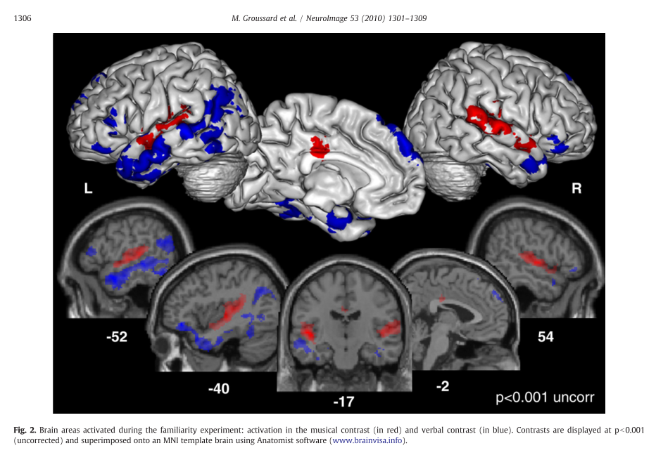
Evidence for separate networks
[Music-Verbal] [Verbal-Music]
Notes:
Music contrast – RED - Bilateral activation in superior temporal gyri, left middle cingulate, and right insula
Verbal contrast – BLUE – left-sided activation in the inferior and middle temporal gyri, medial superior and inferior pars triangularis frontal gyri, posterior MTG, on the right – inferior orbitofrontal cortex, middle temporal pole and the anterior part of the hippocampus and cerebellum

Slide 6
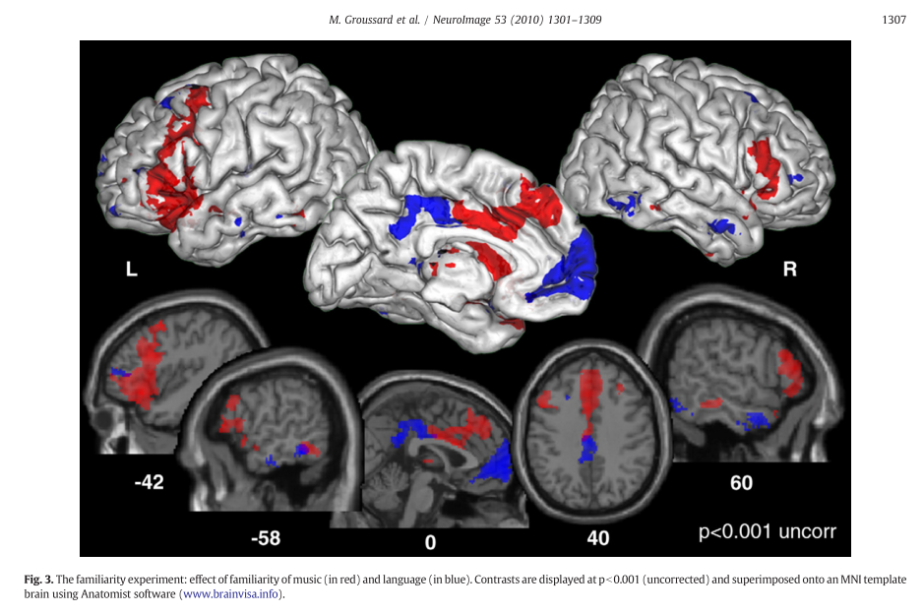
Areas where activity increased with familiarity Music Verbal
Notes:
“parametric regressor modeling familiarity was constructed,”
Greater activity for music in an extended network that included the bilateral inferior frontal gyrus (BA45) (extending to the middle frontal gyrus), the posterior part of the inferior and middle temporal gyri (BA20/37), the medial superior frontal gyrus (BA10) and the right superior temporal pole (BA38).
The verbal familiarity analysis revealed greater activity in the left medial superior frontal gyrus (BA10), the middle cingulate cortex bilaterally, the left putamen and thalamus, and the inferior and middle parts of the frontal (BA47/46) and temporal gyri (BA20/21) bilaterally. We also found activation of the posterior part of the right hippocampus and the left parahippocampal cortex.

Slide 7
Study 1
Identify neural correlates underlying familiar and lyric-based music in healthy adults
BOLD contrasts
Inter-subject synchronization (ISS)
Correlate brain activity during music listening across participants
Synchronized brain activity during music listening (Abrams et al, 2013; Trost et al, 2015)
Novel feature: We will train participants on unknown music
Notes:
ISS: Abrams 2013
We found that music synchronizes brain responses across listeners in bilateral auditory midbrain and thalamus, primary auditory and auditory association cortex, right-lateralized structures in frontal and parietal cortex, and motor planning regions of the brain.

Slide 8
Current Questions
Is there a neural pattern that differentiates familiar from unfamiliar music?
Is it consistent across participants?
How does the presence of lyrics interact with music familiarity?
Is memory better with lyrics?

Slide 9
Project Outline
Scanning session 1
Training – 2-3 weeks
Scanning session 2

Slide 10
Stimuli
16 unfamiliar songs
4 spoken words
4 sung lyrics (acapella, no music)
4 instrumental music only
4 ‘whole’ songs (music + lyrics)

Slide 11
Project Outline
Scanning session 1 – all 16 stim
Baseline familiarity test
ISS and BOLD scans
Training – 2-3 weeks
Scanning session 2

Slide 12
Project Outline
Scanning session 1 – all 16 stim
Baseline familiarity test
ISS and BOLD scans
Training – 2-3 weeks – only 8 stim
Music player with questions
Lab sessions 2x per week
Scanning session 2

Slide 13
Project Outline
Scanning session 1 – all 16 stim
Baseline familiarity test
ISS and BOLD scans
Training – 2-3 weeks – only 8 stim
Music player with questions
Lab sessions 2x per week
Scanning session 2 – all 16 stim
Final familiarity test
ISS and BOLD scans

Slide 14
Familiarity tests
Lyric modification
Forced choice between original and modified lyric
Full set in session 1 and session 2 (~25)
Subset during lab training session (10, monitor progress)
Melody familiarity
Short clips (2 sec) – Old vs New task
learned vs. unlearned songs
During session 2 (~25 clip pairs)
Notes:
----- Meeting Notes (17-05-11 10:57) -----
music + lyrics association

Slide 15
Potential Analyses
Independent Components Analysis
Isolate spatially separate components contributing to memory for music
Compute total ISS score for each song (within each component?)
Familiar vs unfamiliar
Compare total ISS between stimuli types
Lyrics vs non lyrics
Spoken vs sung
Notes:
More synchrony during sung vs spoken
More synchrony during lyrics vs non lyrics
In both cases, there’s more information – strong similarities during movie watching (with lyrics), also synchronization during listening of symphonies (abrams)

Slide 16
Will also collect…
Demographics
Goldsmith’s Musical Sophistication Index
Self-report musical training data
Rhythm abilities
Pitch abilities
Lyric- vs music- focused listeners
Collaboration with Dominique Vuvan (Skidmore College)

Slide 17
Hypotheses
Familiar songs
Greater and earlier ISS than unfamiliar songs
More BOLD activation than unfamiliar songs – left temporal cortex: superior temporal gyrus (Groussard et al 2010)
Lyrics
ISS in language areas: left fusiform gyrus, left inferior occipital gyrus (Saito et al, 2012)
Replication of activation in ‘verbal network’ (Groussard et al 2010)
Instrumental
Bilateral anterior and superior portions of temporal lobes, parahippocampal gyri (Satoh et al, 2006)
Replication of activation in ‘music network’ (Groussard et al 2010)
Lyrics + instrumental (‘whole’)
Overlap with activation to melody only and words only
Specific activation in left posterior inferior temporal cortex (Saito et al, 2012)
Notes:
MAKE THIS BETTER
(e.g. IFG, ITC, MTC)
Language areas: left fusiform gyrus, the left inferior occipital gyrus, and the medial part of the superior frontal gyrus and cingulate gyrus.
Left fusiform – auditory and visual word processing

Slide 18
Next Steps:
Follow up to Study 1
Musical Background
Marker of Consciousness
Alzheimer’s patients

Slide 19
Next Steps: Follow up to Study 1
Why does memory for music last so long?
Bring participants back after 12-18 months for a third scan
Will need to over-recruit during Study 1 to have enough left for the follow-up
Notes:
WHAT DO I EXPECT TO FIND?

Slide 20
Next Steps: Musical Background
Are differences in the music recognition networks found in Study 1 related to the amount/type of musical training a participant has had?

Slide 21
Next Steps: Marker of Consciousness
Suspense-filled audio clips (excerpt from movie Taken) can be used to assess consciousness, but musical stimuli (TV theme songs) did not produce similar activation
Could familiar music be used to assess consciousness?
Notes:
Familiar music, emotionally charge music, music that is relevant to the participant – may produce stronger activation

Slide 22
Next Steps: Alzheimer’s patients

Slide 23
Alzheimer’s disease (AD)
Memory for music seems to be selectively spared
Long-term familiarity for melody and music lyrics is present even in severe AD
Musical semantic memory seems to be preserved (Cuddy et al, 2012)
Theory: spared musical memory is because of intact functioning of necessary brain regions that are spared in AD (Baird & Samson, 2009)

Slide 24
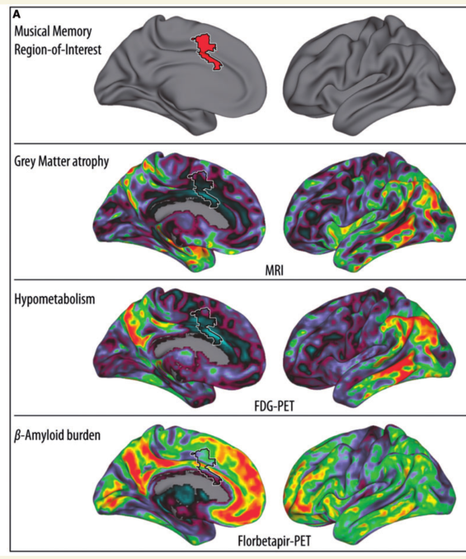
Jacobsen et al, 2015
Notes:
From a memory for music study – determined musical memory ROI
Comapred to data from alzheimer’s patients on biomarkers of disease
ROI is relatively spared

Slide 25
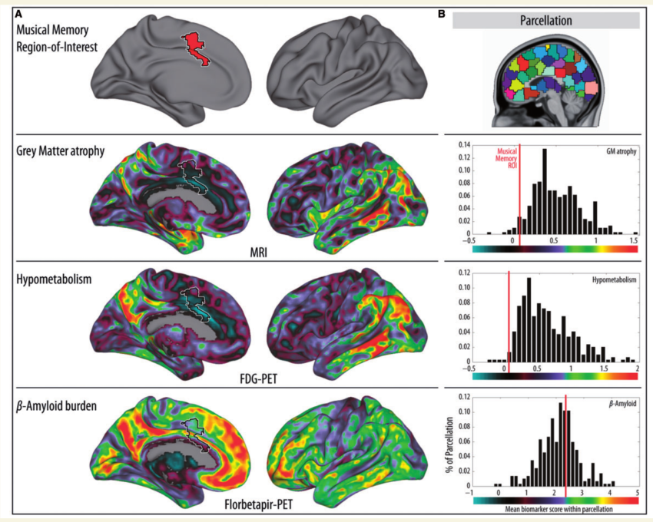
Jacobsen et al, 2015

Slide 26
Next Steps: Alzheimer’s patients
Does synchrony change as the disease progresses?
Does the ’music network’ compensate for deterioration of other memory networks?

Slide 27
Thank you

Slide 28
AD + memories
Music can be used as a memory aid in AD
Learning new song lyrics (Moussard et al, 2012 & 2014; Simmons-Stern et al, 2010 & 2012)
Autobiographical memories can be evoked by music
Memories are more vivid (Belfi et al, 2015)
Memories are more specific (El Haj et al, 2012)
Dorsal MPFC is involved in triggering these memories (Janata, 2009)

